Slide 1


<Aditya Kumar Sony>
<14-Dec-2025>

Slide 2

Outline
Executive Summary
Introduction
Methodology
Results
Conclusion
Appendix

Slide 3
Executive Summary
This project analyzes SpaceX Falcon 9 launches to understand how first-stage reuse impacts launch costs and it provides data for minimizing launch cost.
The methodologies used are:
Data Collection, Data preparation, Exploratory Data Analysis (EDA), Data Visualization and Machine Learning
Summary of all results
Data collection by web-scraping from open source
Feature selection by EDA
Predictive machine learning model for useful information

Slide 4
Introduction
The commercial space age has begun, with private companies making space travel more affordable.
SpaceX leads this revolution through reusable rocket technology and low-cost launches.
Predicting first-stage reuse is key to understanding and reducing launch costs.
This study aims to provide insights from Space X data to Space Y in order to compete Space X using machine learning technique.
The objective is to:
Analyze SpaceX launch data,
Build dashboards for insights,
Predict whether the first stage will be reused using machine learning.

Slide 5

Section 1

Slide 6
Methodology
Executive Summary
Perform data collection methodology
Perform data wrangling
Perform exploratory data analysis (EDA) using visualization and SQL
Perform interactive visual analytics using Folium and Plotly Dash
Perform predictive analysis using classification models

Slide 7
Data Collection
We will be working with SpaceX launch data that is gathered from an API, specifically the SpaceX REST API and from Wikipedia by web scraping.
This API will give us data about launches, including information about the rocket used, payload delivered, launch specifications, landing specifications, and landing outcome.
Our goal is to use this data to predict whether SpaceX will attempt to land a rocket or not. The SpaceX REST API endpoints, or URL, starts with api.spacexdata.com/v4/.
We have the different end points, for example: /capsules and /cores We will be working with the endpoint api.spacexdata.com/v4/launches/past.

Slide 8
Data Collection – SpaceX API
Key phrases:
Public SpaceX data source
Lauch records retrieval
Mission and booster information
Payload and orbit data
Landing outcome data
Dataset consolidation
GitHub URL: https://github.com/adityakumarsony100-stack/Applied-Data-Science-Capstone-Project-IBM/blob/74f5655da2723c50e857c595c66ac2c8c4128261/DataCollection_by_REST_API.ipynb
Flowchart:
Public SpaceX Sources
↓
Launch & Mission Data
↓
Booster & Payload Details
↓
Orbit & Launch Site Info
↓
Landing Outcome Records
↓
Final Combined Dataset

Slide 9
Data Collection - Scraping
Key phrases:
Identify target website
Inspect HTML structure
Parse webpage content
Extract required fields
Store structured data
GitHub URL:https://github.com/adityakumarsony100-stack/Applied-Data-Science-Capstone-Project-IBM/blob/74f5655da2723c50e857c595c66ac2c8c4128261/DataCollection-webscraping.ipynb
Flowchart
Target Website
↓
HTML Inspection
↓
HTTP Request
↓
HTML Parsing
↓
Data Extraction
↓
Structured Dataset

Slide 10
Data Wrangling
Flowchart:
Raw Launch Data
↓
Attribute Selection
↓
Data Cleaning & Formatting
↓
Categorical Variables Identified
↓
Outcome Standardization
(True/False → 1/0)
↓
Final Dataset
(Ready for Analysis & ML)
The data was cleaned and relevant attributes such as launch site, orbit, and landing outcome were selected. The landing outcome was standardized and converted into a binary variable, where 1 indicates a successful first-stage landing and 0 indicates failure. This processed data was then prepared for classification analysis.
Key phrases:
Data collection
Feature selection
Data cleaning
Categorical encoding
Outcome binarization
Ready for Modeling
GitHub URL:https://github.com/adityakumarsony100-stack/Applied-Data-Science-Capstone-Project-IBM/blob/74f5655da2723c50e857c595c66ac2c8c4128261/labs-jupyter-spacex-Data%20wrangling.ipynb

Slide 11
EDA with Data Visualization
Exploratory data analysis helps to understand the relationship between different variable. It helps in feature selection
The plots generated are:
Catplot
Scatterplot
Barchart
Line plot
Heatmap
Boxplots
Github URL:https://github.com/adityakumarsony100-stack/Applied-Data-Science-Capstone-Project-IBM/blob/74f5655da2723c50e857c595c66ac2c8c4128261/EDA.ipynb

Slide 12
EDA with SQL
Summary of the SQL queries performed are:
Display the number of unique launch sites in the space mission
Display 5 records where launch sites begin with the string 'CCA’
Display the total payload mass carried by boosters launched by NASA(CRS)
Display average payload mass carried by booster version F9 v1.1
List the date when the first successful landing outcome in ground pad was acheived.
List the names of the boosters which have success in drone ship and have payload mass greater than 4000 but less than 6000
List the total number of successful and failure mission outcome
List all the booster_versions that have carried the maximum payload mass, using a subquery with a suitable aggregate function.
List the records which will display the month names, failure landing_outcomes in drone ship ,booster versions, launch_site for the months in year 2015.
Rank the count of landing outcomes (such as Failure (drone ship) or Success (ground pad)) between the date 2010-06-04 and 2017-03-20, in descending order.
Githhub URL: https://github.com/adityakumarsony100-stack/Applied-Data-Science-Capstone-Project-IBM/blob/74f5655da2723c50e857c595c66ac2c8c4128261/jupyter-labs-eda-sql-coursera_sqllite%20(1).ipynb

Slide 13
Build an Interactive Map with Folium
Markers (folium.Marker): Used to pinpoint exact locations such as launch sites, closest coastline points, cities, railways, and highways. Markers can have customized icons or colors (e.g., green for success, red for failure) to represent different statuses.
Marker Clusters (folium.plugins.MarkerCluster): Group multiple markers together to improve map readability when many points are close to each other. This helps in managing overlapping markers on the map.
Circles (folium.Circle): Added around launch sites or other points to highlight an area with a radius, often with popup labels to provide additional information.
Lines (folium.PolyLine): Drawn between two points (e.g., launch site and closest feature like coastline or city) to visually represent the proximity or connection between them.
DivIcon Markers (folium.features.DivIcon): Custom markers that display text labels directly on the map, such as showing the calculated distance between two points in kilometers.
These objects together create an interactive and informative map that helps you analyze spatial relationships related to launch sites.
Github URL:https://github.com/adityakumarsony100-stack/Applied-Data-Science-Capstone-Project-IBM/blob/74f5655da2723c50e857c595c66ac2c8c4128261/lab_jupyter_launch_site_location%20Folium.ipynb

Slide 14
Build a Dashboard with Plotly Dash
Plots/Graphs:
Pie Chart: Shows launch success counts overall or by selected launch site.
Scatter Plot: Shows payload mass vs. launch success, color-coded by booster version.
Interactions:
Dropdown: Select launch site to update pie chart.
Range Slider: Filter payload range to update scatter plot.
Why:
These plots and controls let you explore launch success visually and interactively, helping you analyze SpaceX data easily in your cloud IDE.
Add the GitHub URL: https://github.com/adityakumarsony100-stack/Applied-Data-Science-Capstone-Project-IBM/blob/74f5655da2723c50e857c595c66ac2c8c4128261/spacex-dash-app.py

Slide 15
Predictive Analysis (Classification)
Flowchart:
Prepare Data
│
Choose Algorithms
│
Initialize Models
│
Train Models
│
Cross-Validation
│
Evaluate Metrics
│
Hyperparameter Tuning ──> Feature Engineering
│ │
└─────────> Model Selection
│
Select Best Model
│
Review Hyperparameters
│
Finalize Model
1. Build Model
Prepare Data → Clean, preprocess, normalize/standardize, split train/test
Choose Algorithms → SVM, Decision Tree, Logistic Regression, KNN
Initialize Models → Create model objects
2. Evaluate Model
Train Models → Fit on training data
Cross-Validation → GridSearchCV with CV
Metrics → Test accuracy / performance evaluation
3. Improve Model
Hyperparameter Tuning → GridSearchCV for best params
Feature Engineering → Create/select better features
Model Selection → Compare tuned models
4. Select Best Model
Identify best model → Highest accuracy / performance
Review hyperparameters → From grid search
Finalize model → Ready for deployment
GitHub URL: https://github.com/adityakumarsony100-stack/Applied-Data-Science-Capstone-Project-IBM/blob/74f5655da2723c50e857c595c66ac2c8c4128261/SpaceX_Machine%20Learning%20Prediction_Part_5.ipynb

Slide 16
Results
Exploratory data analysis results
Interactive analytics demo in screenshots
Predictive analysis results

Slide 17

Section 2

Slide 18
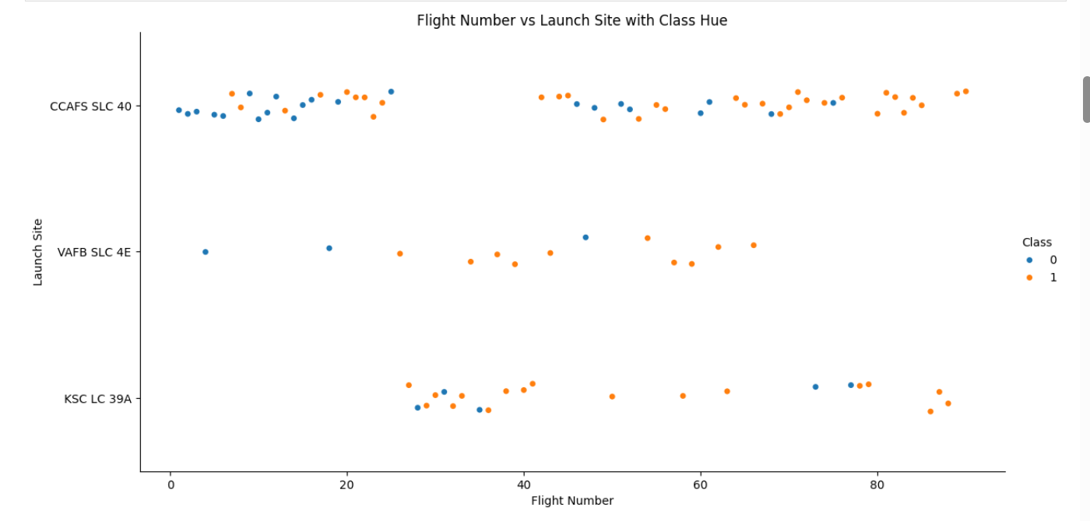
Flight Number vs. Launch Site
The pattern between Flight Number and Launch Site shows how launch activity varies over time at different sites.
Higher flight numbers indicate later launches, and you can see which sites were active during those times.
Success rates (hue 'Class') may also vary by site and flight number.

Slide 19
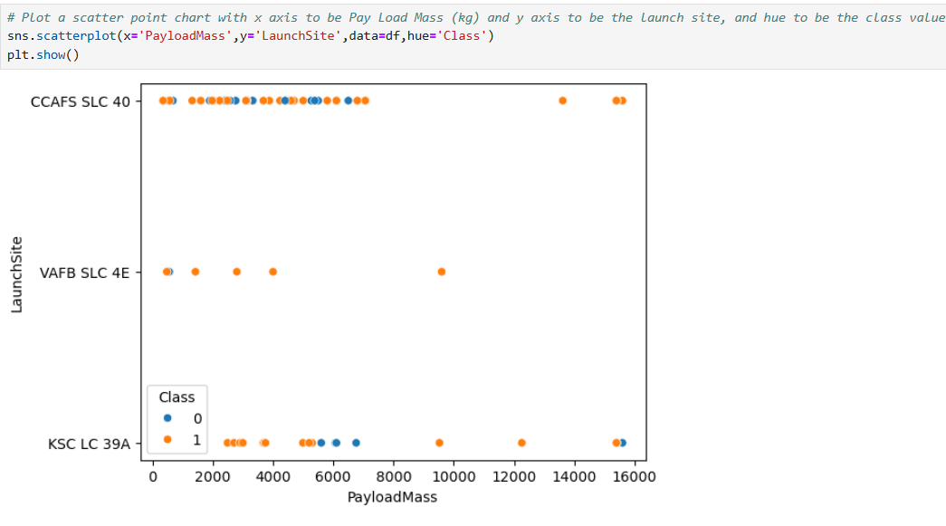
Payload vs. Launch Site
The pattern shows that some launch sites (like VAFB-SLC) don’t launch heavy payloads (over 10,000 kg), while others handle a wider range of payload masses.
This indicates site-specific payload capabilities.

Slide 20
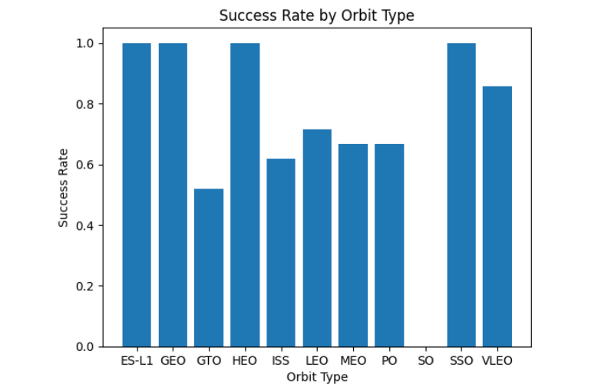
Success Rate vs. Orbit Type
The pattern shows that orbits like LEO and ISS have the highest success rates, while others like GTO tend to have lower success.
This indicates launches to certain orbits are more reliable.

Slide 21
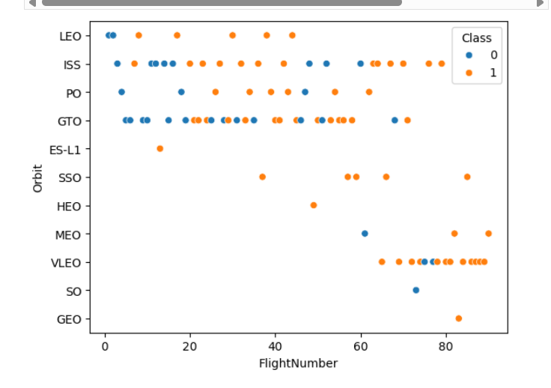
Flight Number vs. Orbit Type
The pattern between Orbit Type and Flight Number shows how different orbits have been targeted over time.
Early flight numbers may focus on certain orbits, while later flights expand to others.
Some orbits have more frequent launches, reflected by more flight numbers.
This trend helps understand the evolution of mission goals and orbit preferences.

Slide 22
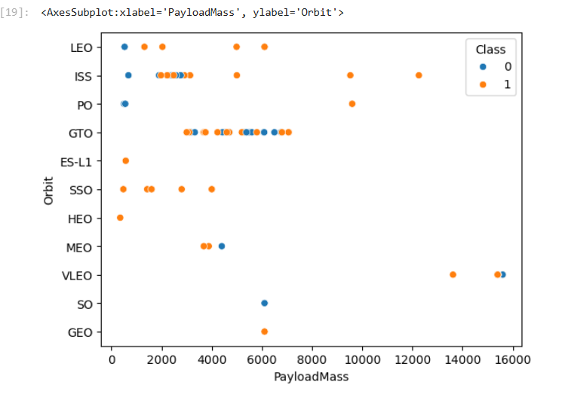
Payload vs. Orbit Type
Heavier payloads are usually launched to orbits like GTO, while lighter payloads go to LEO.
This shows how payload mass varies with orbit type.

Slide 23
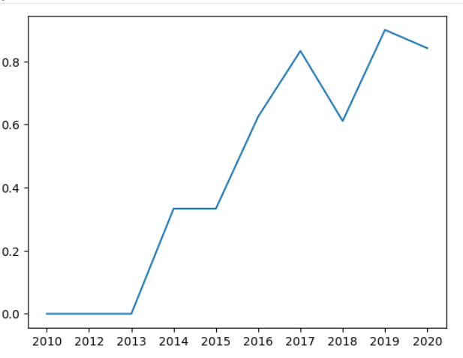
Launch Success Yearly Trend
This chart shows Lauch Success is increasing yearly with some fluctuations.

Slide 24
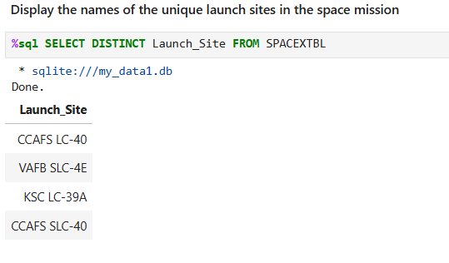
All Launch Site Names

Slide 25
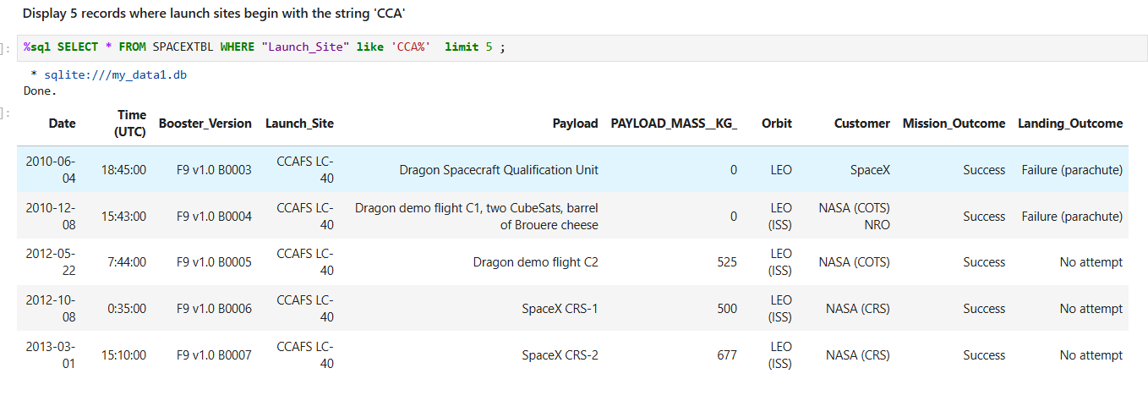
Launch Site Names Begin with 'CCA'

Slide 26
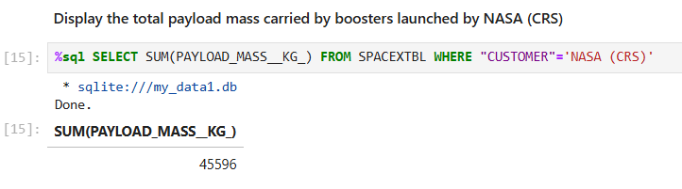
Total Payload Mass

Slide 27
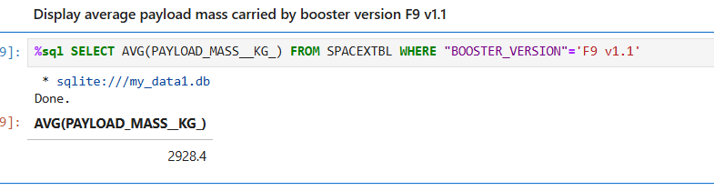
Average Payload Mass by F9 v1.1

Slide 28
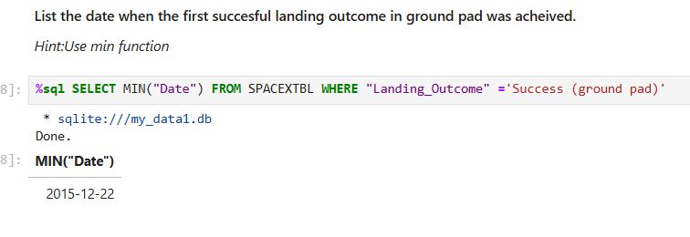
First Successful Ground Landing Date

Slide 29
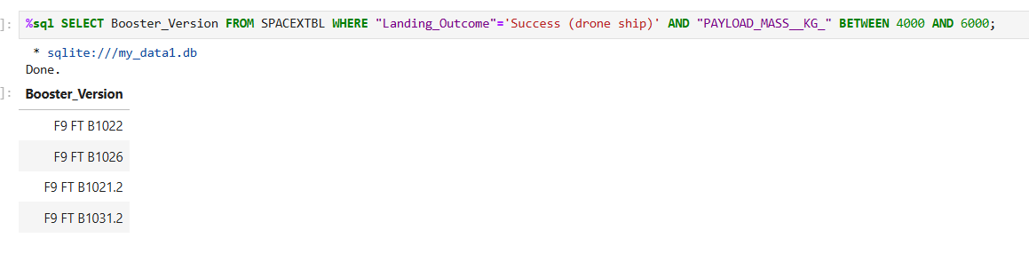
Successful Drone Ship Landing with Payload between 4000 and 6000

Slide 30
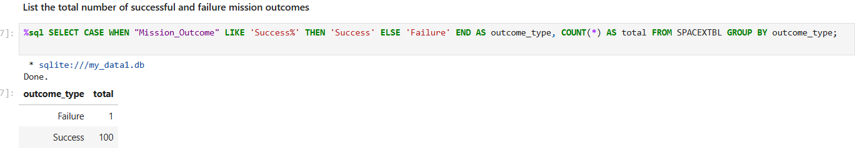
Total Number of Successful and Failure Mission Outcomes

Slide 31
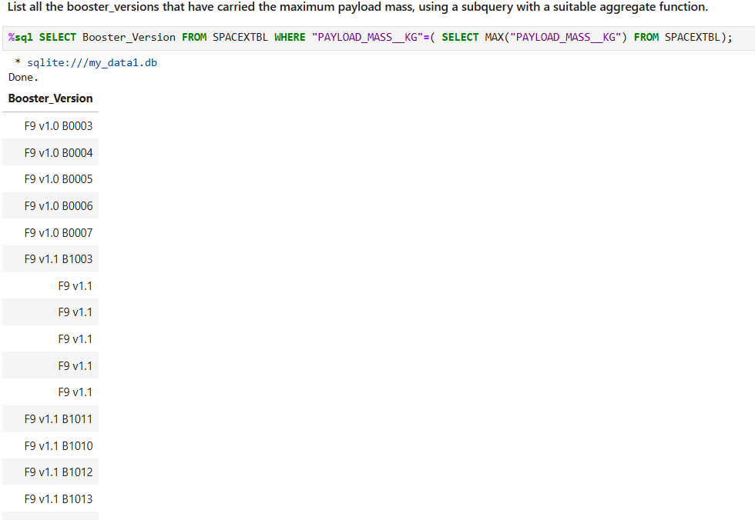
Boosters Carried Maximum Payload

Slide 32
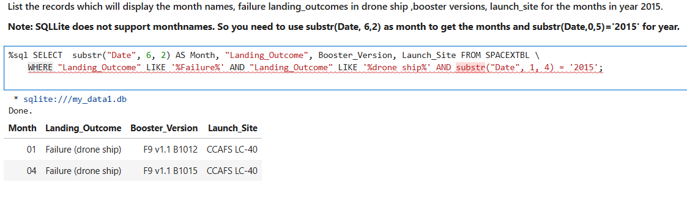
2015 Launch Records

Slide 33
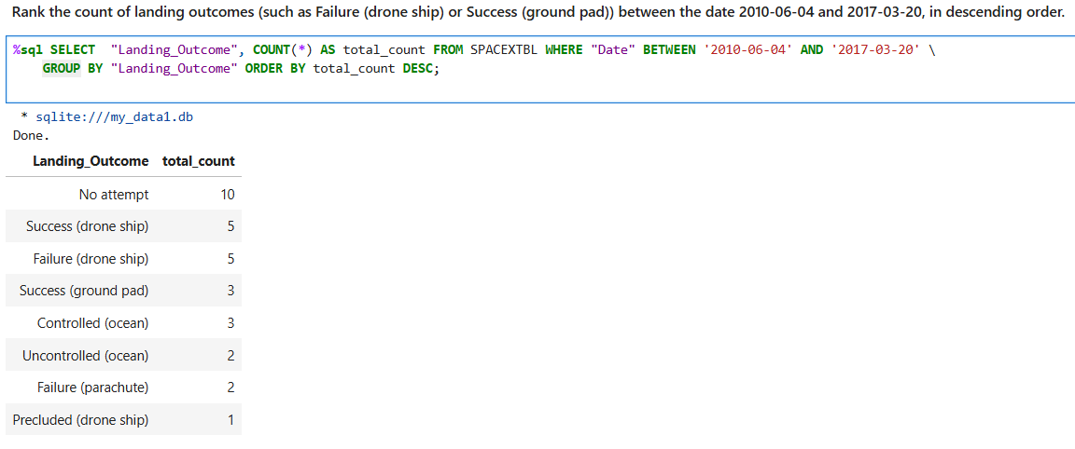
Rank Landing Outcomes Between 2010-06-04 and 2017-03-20

Slide 34

Section 3

Slide 35
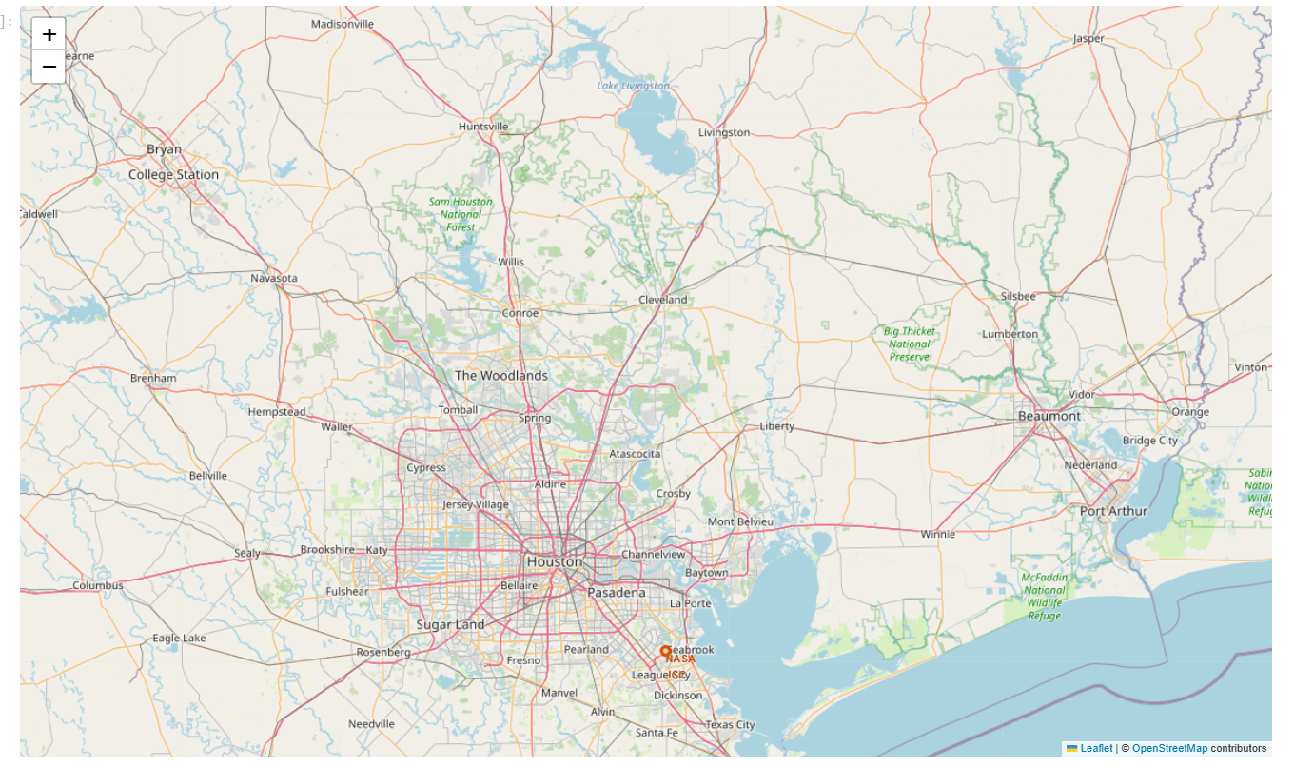
<Folium Map of Launch Site>
This map shows launch site location of NASA JSC near Houston area.

Slide 36
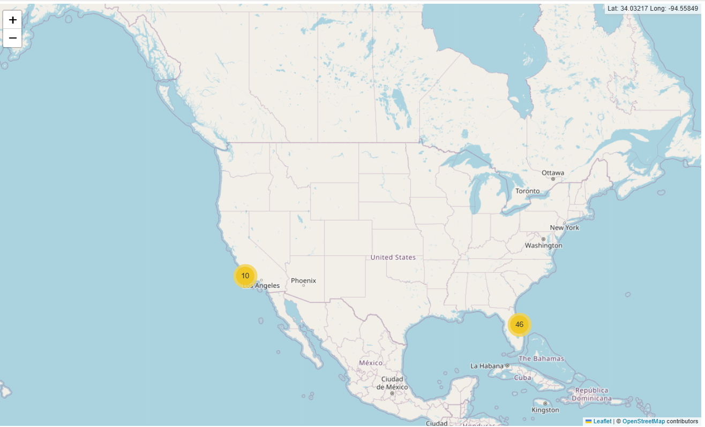
<Folium Map with colored label>
This map shows colored label of launch sites
This shows launch sites are near coastal area.

Slide 37
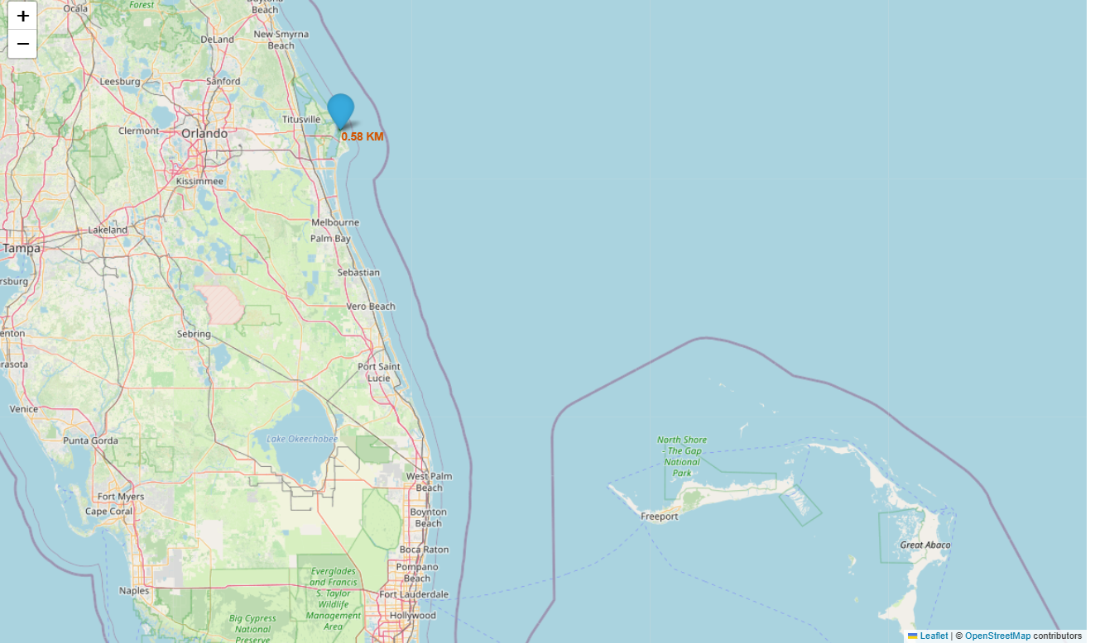
<Folium Map of Lauch Site to its proximities>
This map shows a marker with distance to a closest city, railway, highway,

Slide 38

Section 4

Slide 39
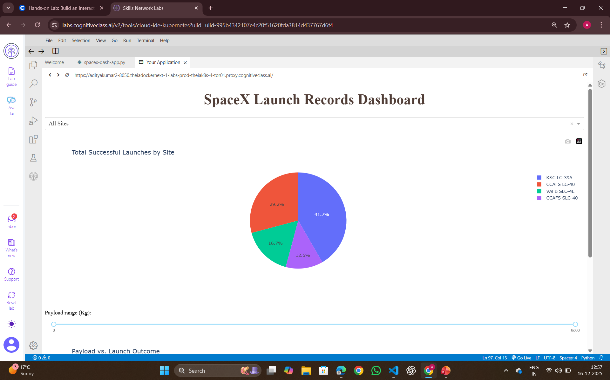
<Launch Success Count of all Sites>
This pie-chart shows total successful launches by all sites.
The KSC LC-39A has most successful launches than other sites.

Slide 40
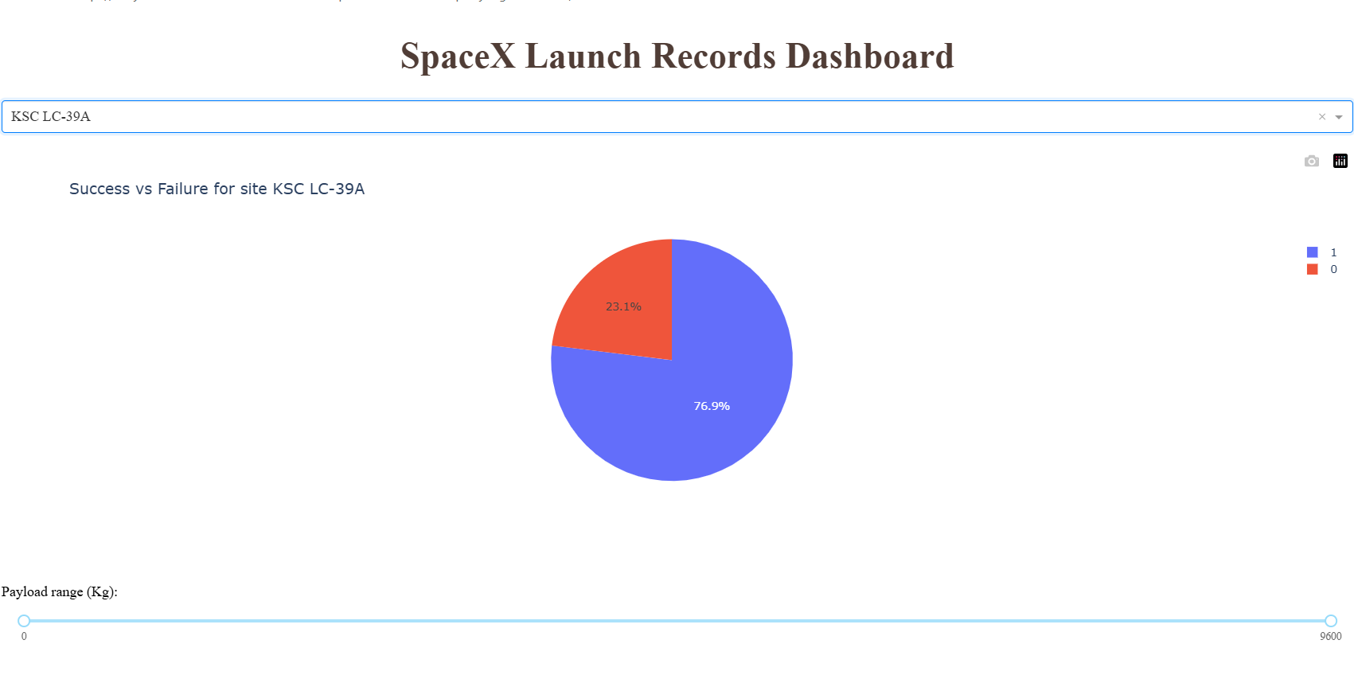
<Launch Site with highest success ratio>
KSC LC-39A has highest success ratio.
The success percentage is 76.9% whereas failure percentage is 23.1%.

Slide 41
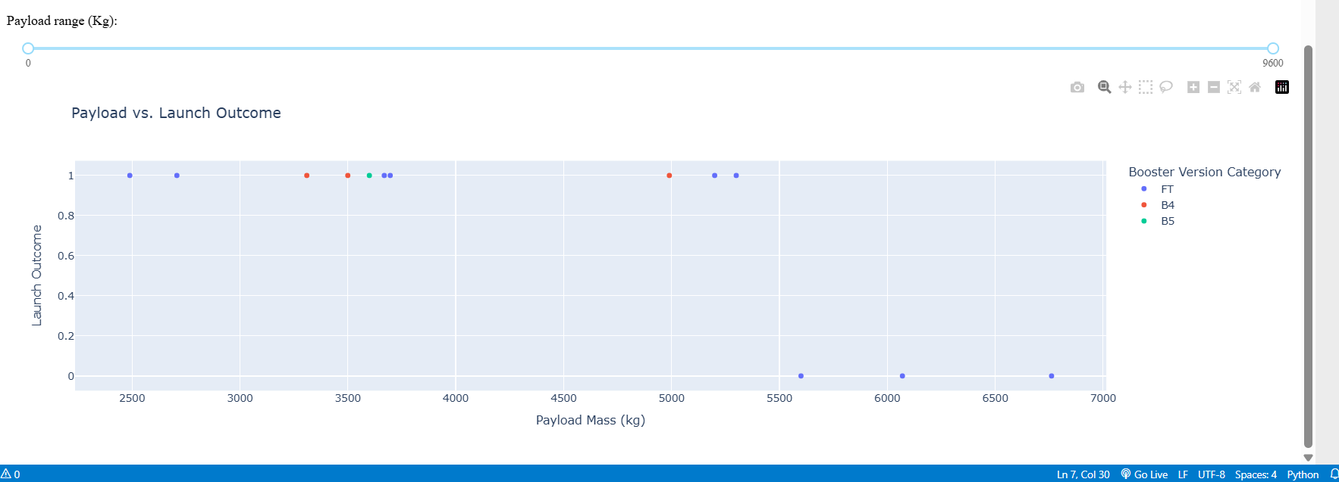
< Payload vs. Launch Outcome scatter plot for all sites >
The payload range (0-9600) has highest success Launch outcome.
Booster Version FT has highest success Launch outcome.

Slide 42

Section 5

Slide 43
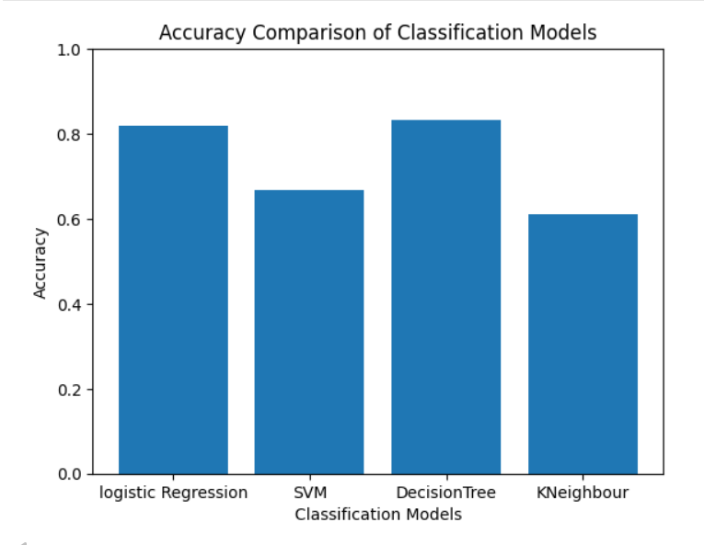
Classification Accuracy
Decision Tree Classifier Model has highest accuracy that is 0.83334

Slide 44
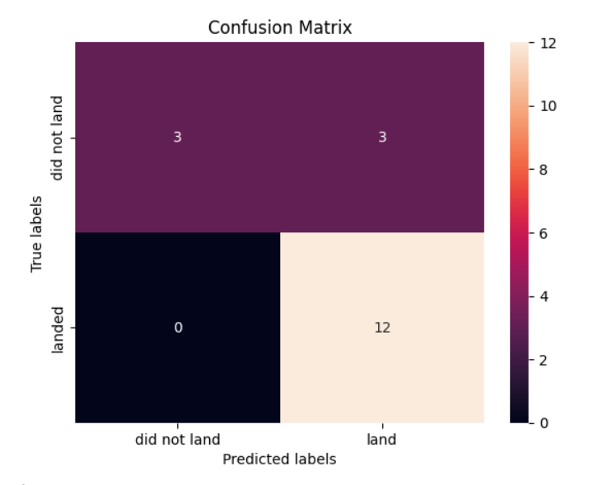
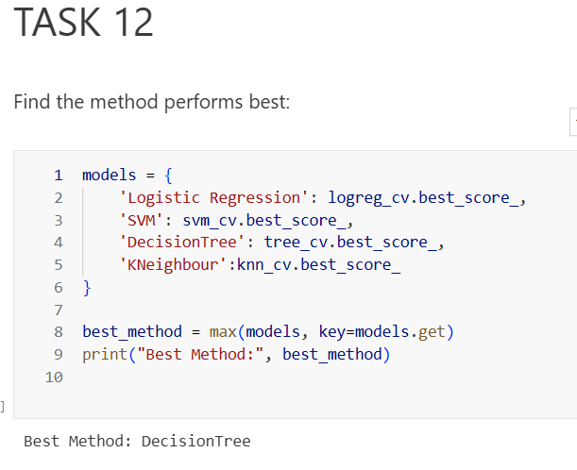
Confusion Matrix
Best performing model

Slide 45
Conclusions
Higher the flight number at launch site, higher is success rate
Launch success rate is found to be improving after each year.
Orbits ES-L1,GEO, HEO, SSO, VLEO had high success rate
KSC LC-39A had most success rate than any launch sites
Decision Tree Classifier is found to be most accurate predictive model.

Slide 46
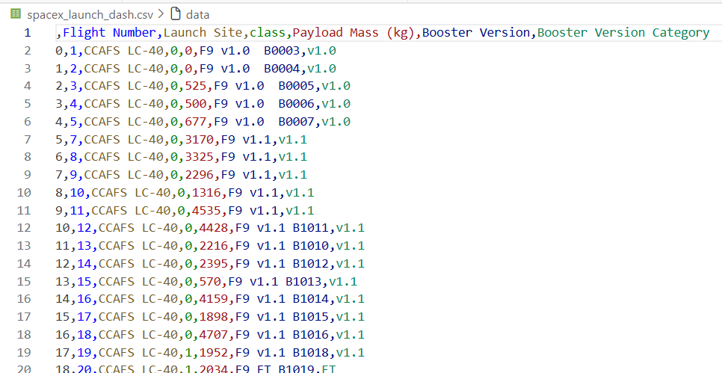
Appendix
Every work is done with python language and in EDA we have used SQL too.
Example of extracted dataset includes is :

Slide 47


